Slide 1
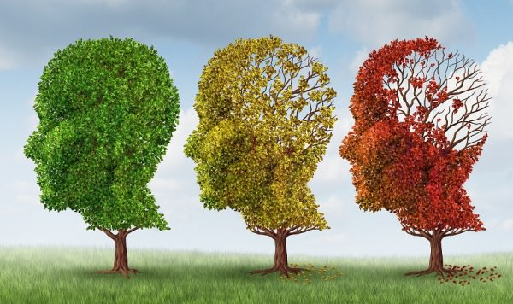
Mining Brain Network of Alzheimer’s Disease Patients
By
A'aeshah Alhakamy, Kumud Bhat, KHan Al Farabi, Jiachen Wang
Prof. Yuni Xia

Slide 2
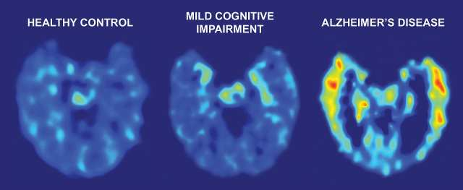
Introduction
Alzheimer's disease (AD)
Mild Cognitive Impaired (MCI)
Dynamically neurodegenerative disease.
It is the most widely recognized kind of dementia in elderly patients.
5 million in the U.S.
Transitional stage between the expected cognitive decay of ordinary aging and the most genuine decrease of dementia
Some people with mild cognitive impairment get worse, and a few ultimately get better.

Slide 3
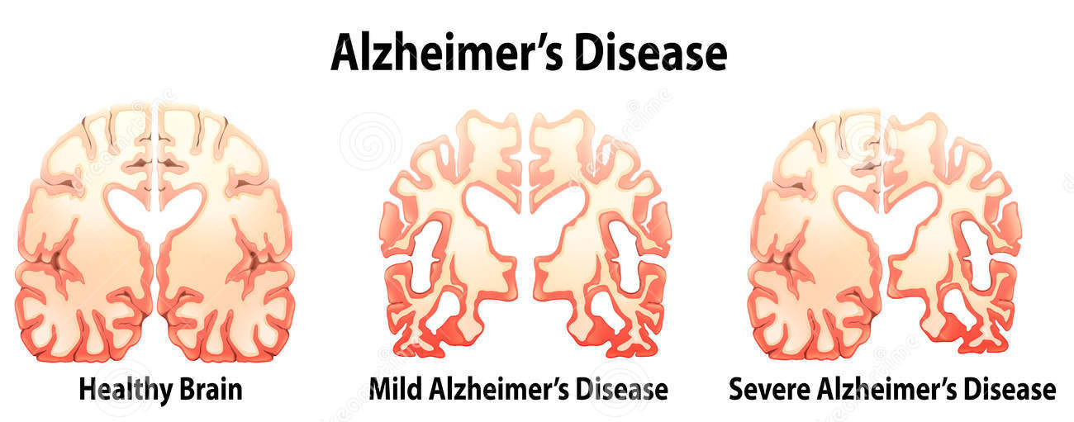
Introduction
Efficient diagnosis of Alzheimer's disease (AD)
Identified the structure change of the brain network, i.e., the connectivity among different brain regions.
The brain region of interest (ROIs) and neural connections among them will provide useful pattern-based biomarkers to recognize:
healthy control (HC)
Mild Cognitive Impairment (MCI),
AD.

Slide 4
Introduction
To achieve this goal we use state of the art machine learning techniques.
We used GNU Octave, MATLAB and C++ (VTK, QT):
Dimensionality Reduction Algorithms
Principal Component Analysis (PCA)
Linear Discriminant Analysis (LDA)
Clustering Algorithms
k-Means
Density-based clustering (DBSCAN)
Classification Algorithms
Support Vector Machine (SVM)

Slide 5
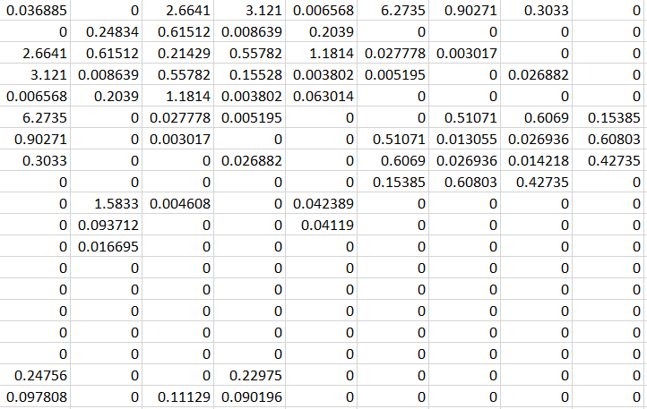
Data Acquisition and Preprocessing
The original datasets were provided by radiology department, IU School of Medicine.
There are three files of original data: AD ,MCI ,HC
The data were collected from a total of 104 subjects: 43 for HC, 42 for MCI and 19 for AD.
For each subject, 234 ROIs were segmented.
For each person, the brain network data is presented in 234 X 234 matrix.
The brain is divided into 234 regions of interests (ROI),
each number shows the weighted connection between two ROIs.
Some are 0, which means there is no talk between those two regions.
In AD file there are 4446 X 234, that’s because we listed the matrices from all the 19 patients together

Slide 6
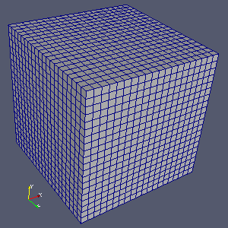
Data Visualization
Datasets and visualization tools:
C++ and visualization toolkit(VTK)
19 subjects for each group(AD, HC).
234 region of interest(ROI) per each subject
Structure points
Volume rendering:
color function
opacity function
Gaussian splatter

Slide 7
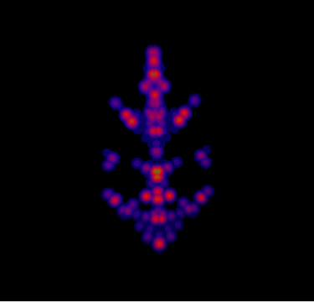
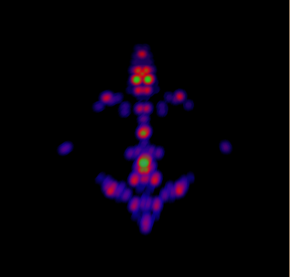
Visualization of average data
HC
AD

Slide 8
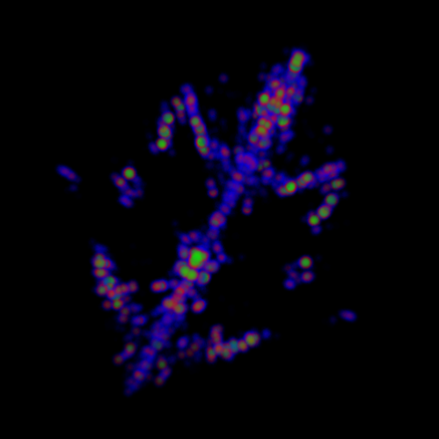
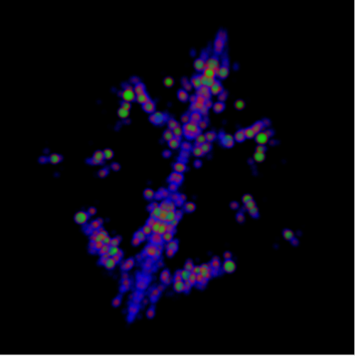
Visualization Results
HC
AD

Slide 9
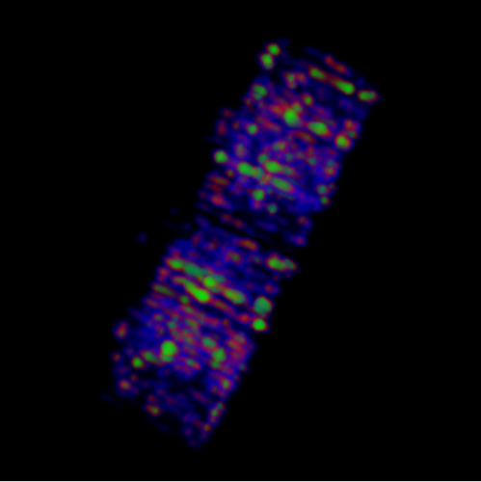
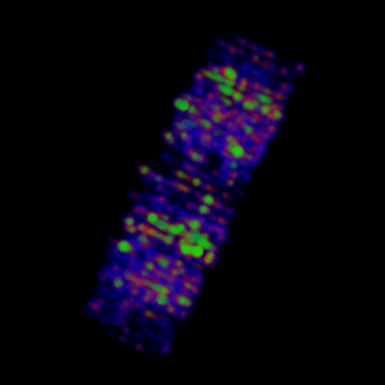
Visualization Results
HC
AD

Slide 10
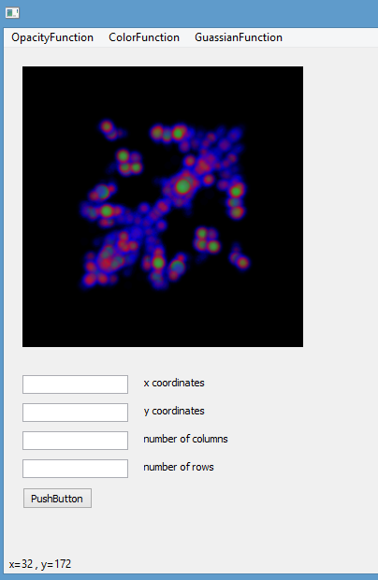
Feature Extraction

Slide 11
Principal Component Analysis (PCA)
Take the whole dataset consisting of d-dimensional samples ignoring the class labels
Compute the d-dimensional mean vector (i.e., the means for every dimension of the whole dataset)
Compute the scatter matrix (alternatively, the covariance matrix) of the whole data set
Compute eigenvectors (e1,e2,...,ed) and corresponding eigenvalues (λ1,λ2,...,λd)
Sort the eigenvectors by decreasing eigenvalues and choose k eigenvectors with the largest eigenvalues to form a d×k dimensional matrix W(where every column represents an eigenvector)
Use this d×k eigenvector matrix to transform the samples onto the new subspace. This can be summarized by the mathematical equation: y=WT×x (where x is a d×1-dimensional vector representing one sample, and y is the transformed k×1-dimensional sample in the new subspace.)

Slide 12
Principal Component Analysis (PCA)
For the first features, for all three data sets (AD,HC,MCI)the original dimension is 520x51 matrix . After applying PCA it is reduced to 51x 51.
For the second features, for all three data sets (AD,HC,MCI)the original dimension is 190x17 matrix . After applying PCA it is reduced to 17x 17.

Slide 13
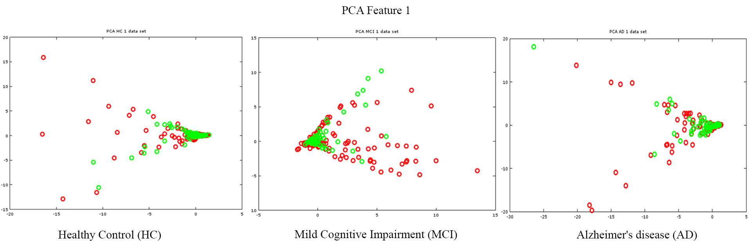
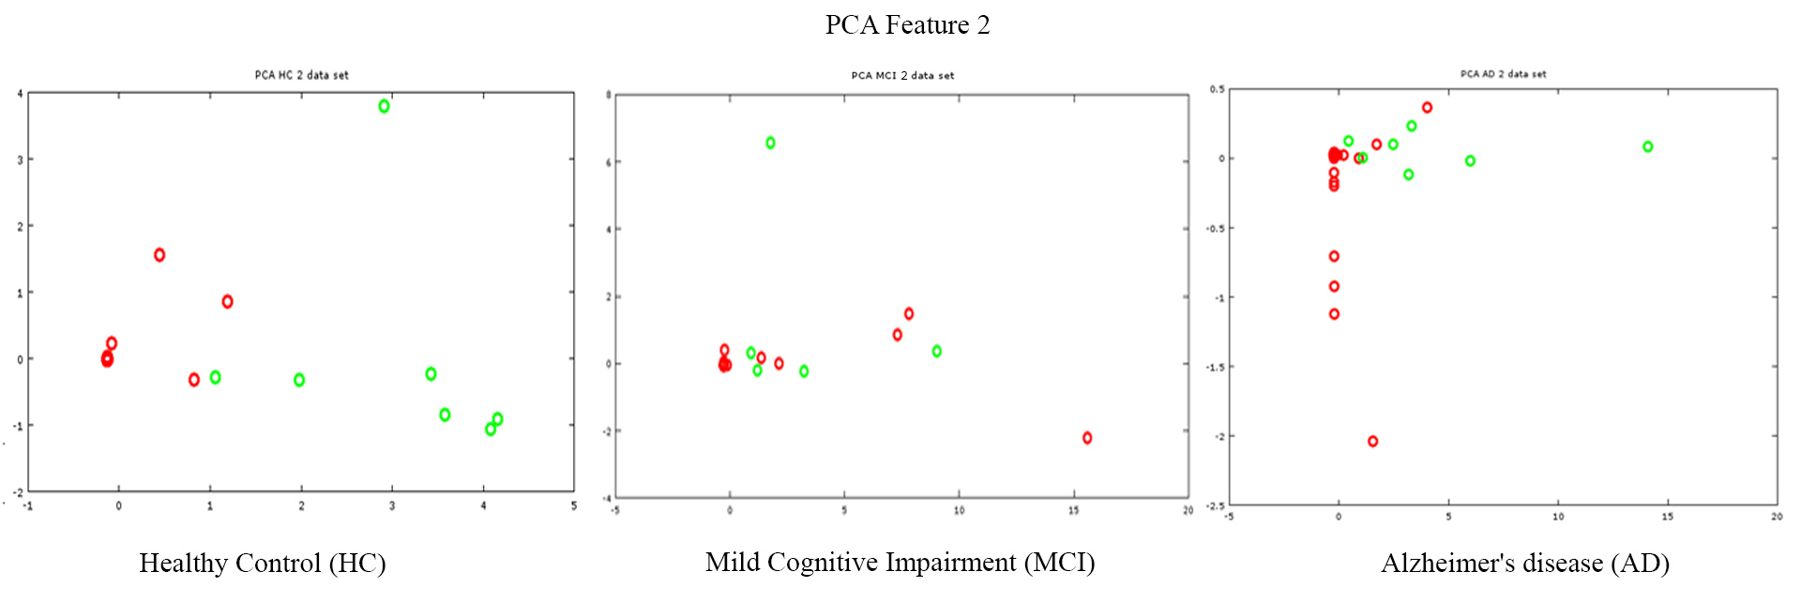

Slide 14
Linear Discriminant Analysis (LDA)
LDA provides the final transformation where between class scatter is maximized and within class scatter is minimized.
LDA attempts to provide linear combination of the features to separate two or more classes.
LDA like PCA also reduce the dimension of the data sets.
In our implementation we have used LDA to reduce the dimension and for better visualization of the separated classes.

Slide 15
Linear Discriminant Analysis (LDA)
Compute the d-dimensional mean vectors for the different classes from the dataset.
Compute the scatter matrices (between-class and within-class scatter matrix).
Compute the eigenvectors (e₁, e₂, ..., e_{d}) and corresponding eigenvalues (λ₁, λ₂, ..., λ_{d}) for the scatter matrices.
Sort the eigenvectors by decreasing eigenvalues and choose k eigenvectors with the largest eigenvalues to form a d×k-dimensional matrix W (where every column represents an eigenvector).
Use this d×k eigenvector matrix to transform the samples onto the new subspace. This can be summarized by the equation Y = X × W (where X is an n×d-dimensional matrix; the ith row represents the ith sample, and Y is the transformed n×k-dimensional matrix with the n samples projected into the new subspace).
For the First feature Y is 520x2 and for the second feature Y is 190x2 in LDA.

Slide 16
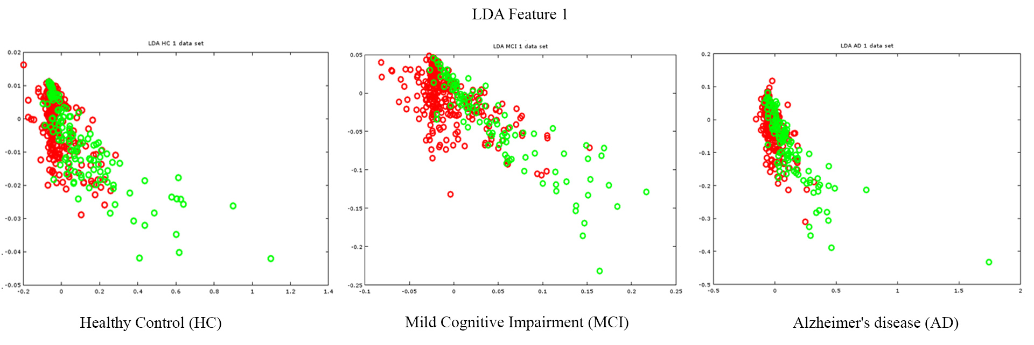
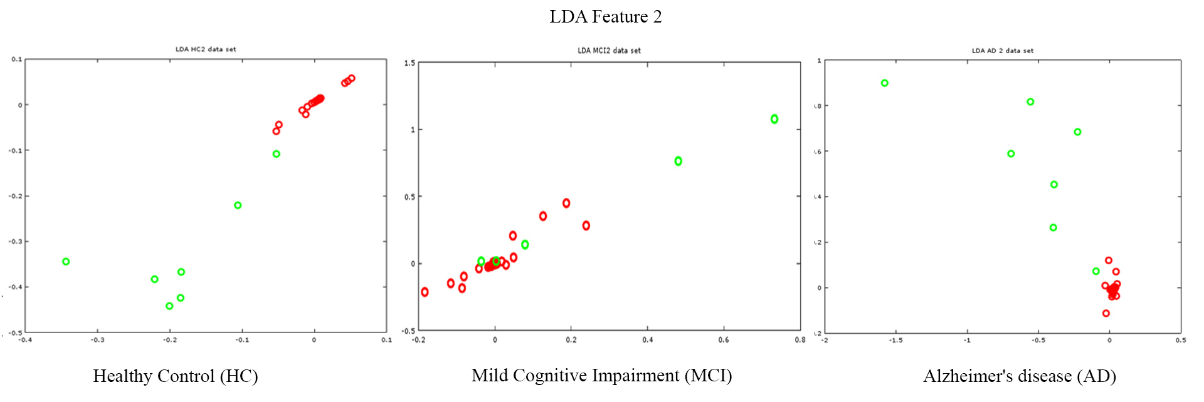

Slide 17
Support Vector Machine (SVM)
For a linearly separable dataset, a linear classification function compares to an isolating hyperplane f (x) that goes through the center of the two classes, separating the two.
When this function is resolved, new data case xn can be classified by basically testing the indication of the function f (xn); xn fits in with the positive class if f (xn) > 0.
Since there are numerous such linear hyperplanes, what SVM further guarantee is that the best such function is found by boosting the margin between the two classes.
Instinctively, the margin is characterized as the measure of space, or separation between the two classes as characterized by the hyperplane.
The margin compares to the most limited separation between the nearest data points to a point on the hyperplane.

Slide 18
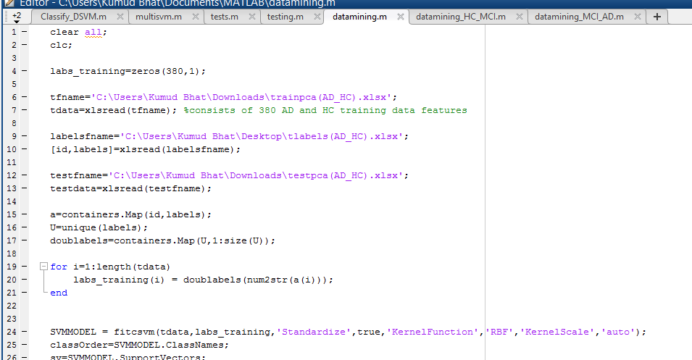
Three CASes
AD_HC without pca -> misclassification error: 0.48 accuracy: 52% AD_HC with pca -> Misclassification error: 0.039 accuracy: 96.1%
2) HC_MCI without pca -> misclassification error: 0.48 accuracy: 52% 2) HC_MCI with pca -> misclassification error: 0.039 accuracy: 96.1%
3) MCI_AD with pca -> misclassification error: 0.044 accuracy: 95.53%

Slide 19
Density-based clustering (DBSCAN)
The algoritm steps are as follows,
Select an arbitrary point p
Retrieve all points density-reachable from p w.r.t. Eps and Minpts.
If p is a core point, a cluster is formed.
If p is a border point, no points are density reachable from p and DBSCAN visits the next point of the database.
Continue the process until all the points have been processed.

Slide 20
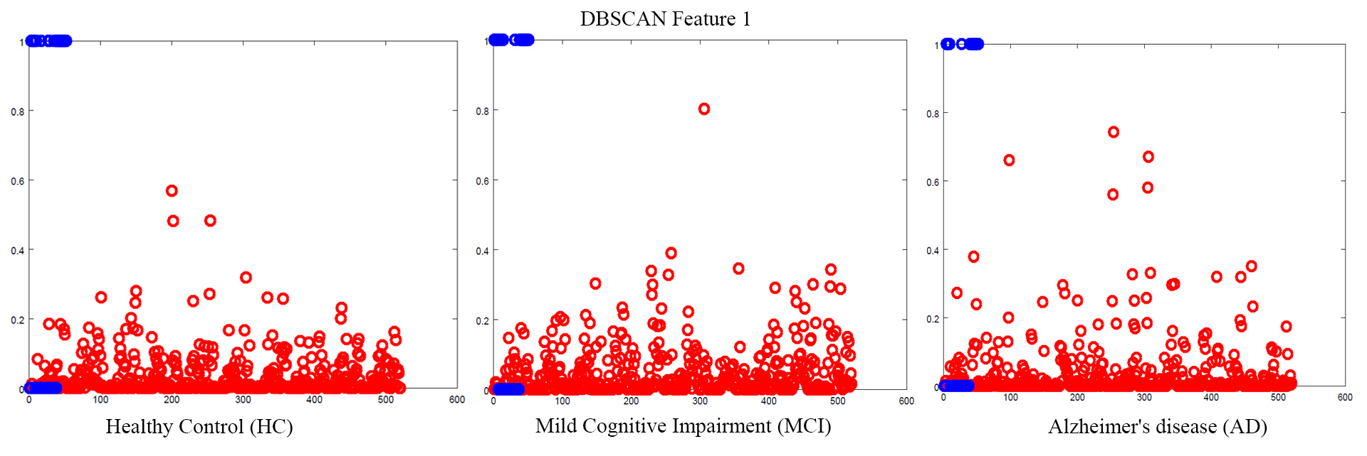
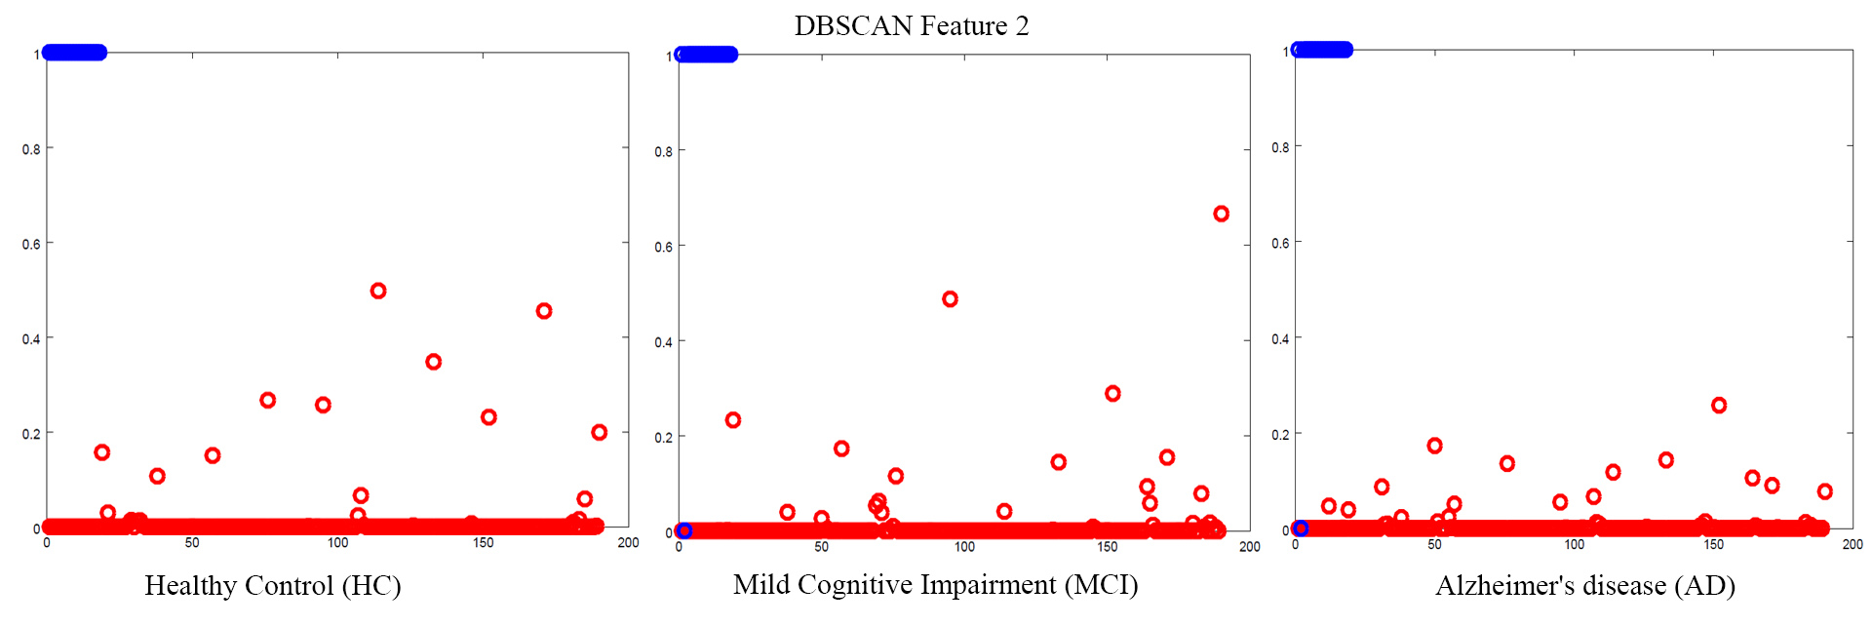

Slide 21

K-means
Here are the main steps to accomplish this algorithm:
Randomly select ‘c’ cluster centers.
Calculate the distance between each data point and cluster centers.
Assign the data point to the cluster center whose distance from the cluster center is a minimum of all the cluster centers.
Recalculate the new cluster center using:
Recalculate the distance between each data point and newly obtained cluster centers.
If no data point was reassigned then stop, otherwise repeat from step 3).
For both k-means and DBSCAN, in the first feature the input matrix of AD, HC, MCI is 520x52 and for the second feature is 190x18.

Slide 22
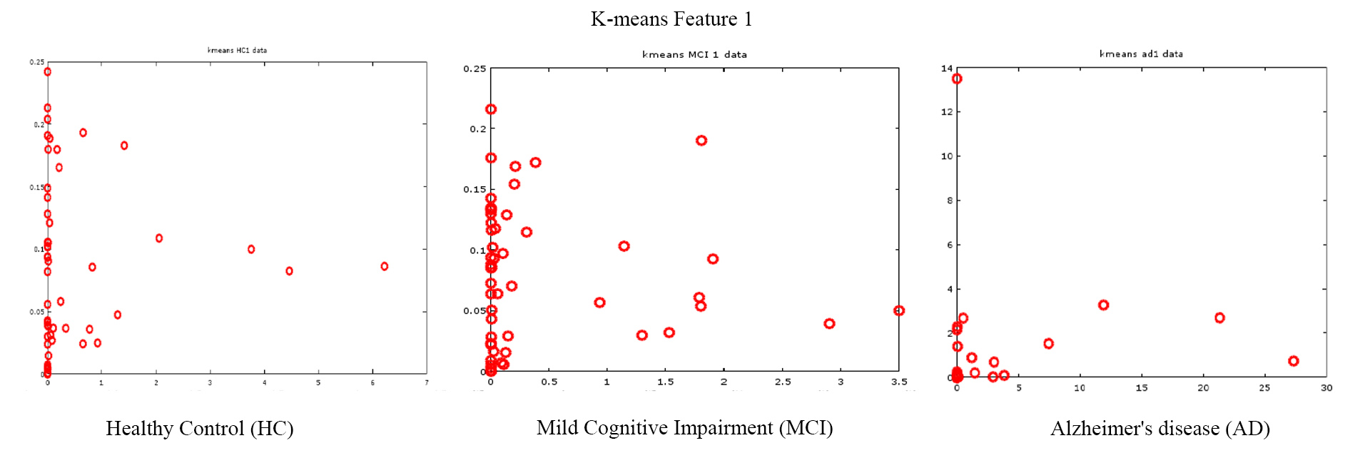
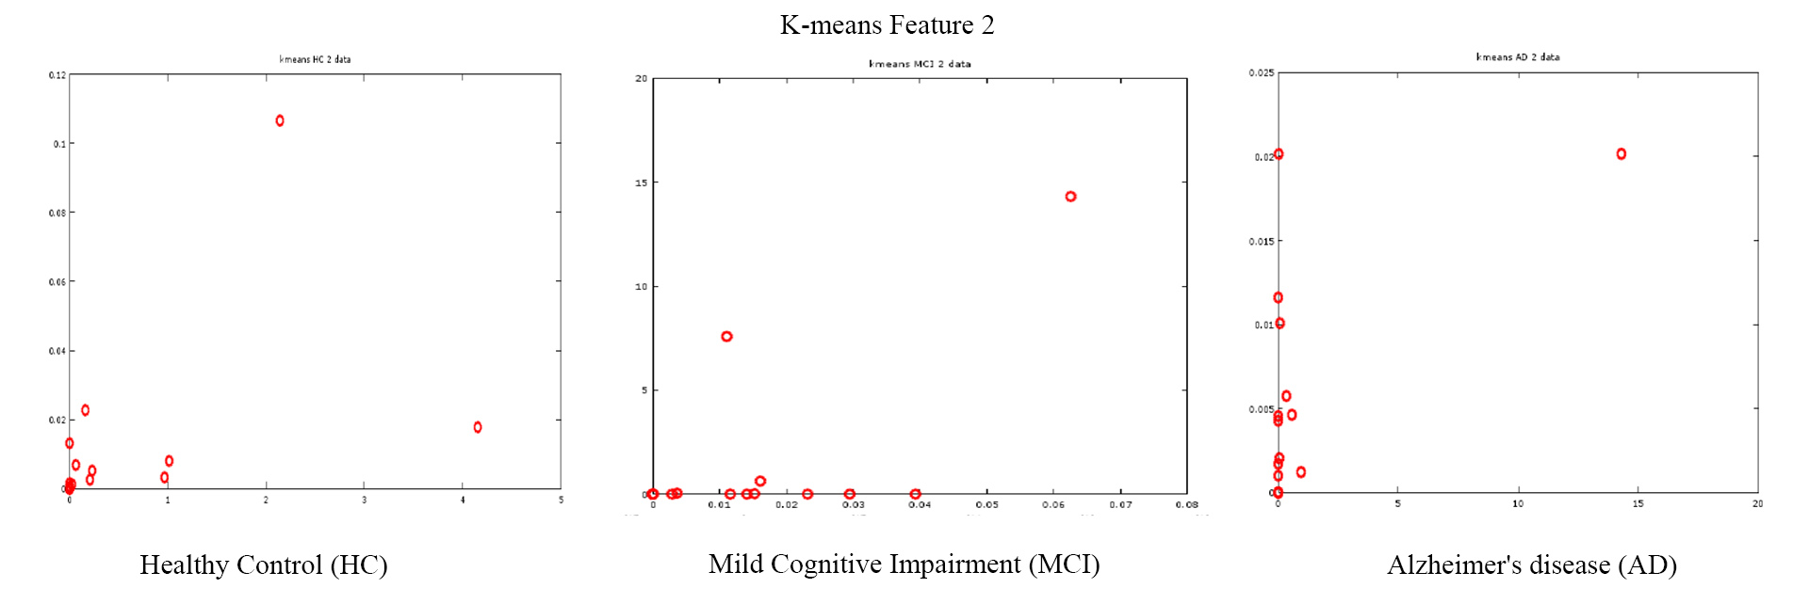

Slide 23
Summary
We studied the brain networks of Alzheimer's disease patients, Mild Cognitive Impaired and healthy people.
We visualized the brain networks and extracted the features which represent the differences among those three groups.
We applied different algorithms to process and analyze the features.
We generated a svm model, which we can use to predict Alzheimer’s disease. For the features we tested, we are able to achieve a relatively high accuracy.

Slide 24
Future work
Use LDA result with SVM and compare the results that we got from PCA.
Attempt to use Support Vector Clustering (SVC) instead of SVM which not required labeling.
Try to extract more features and apply the algorithms on them.

Slide 25
Thank you!

